Slide 1
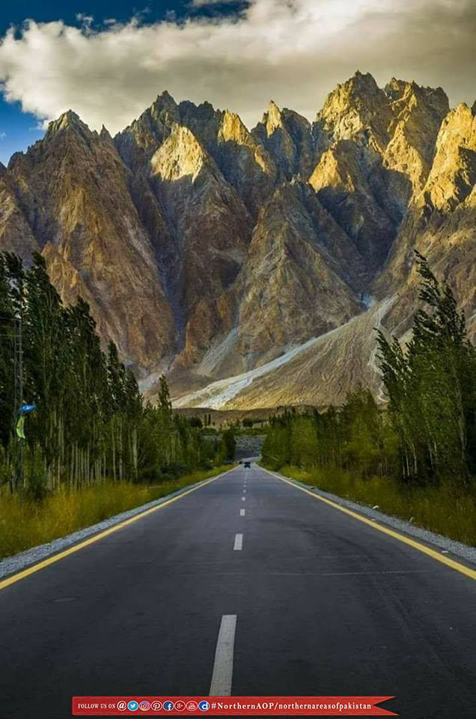
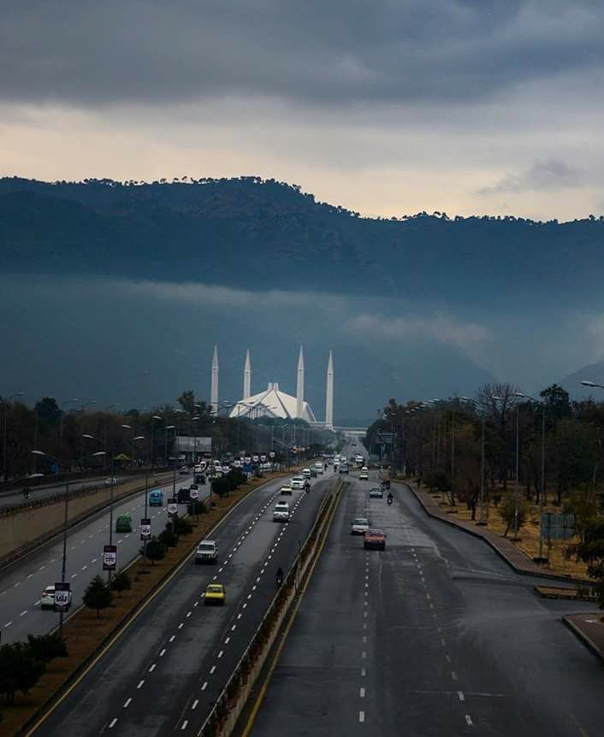


(DEVELOPMENT)
Members:
Hamza Rauf 21i-0604
Shamail Aamir Khan 21i-1772
Eman Furrukh 21i-1726
Supervisor: Mr. Bilal Khalid Dar
Co-Supervisor: Ms. Zoya Mahboob

Slide 2

VOYAIGE
02/17
Project
Overview
1. Problem Statement
slide 3
6. Process Flow
slide 11
2. Problem Solution
slide 4
7. Tools & Technology
slide 12
3. Goals
slide 5
8. Skills Assessment
slide 13
4. Existing Systems
slide 6
9. Timeline
slide 14
5. Scope & Modules
slide 10
10. Work Division
slide 15

Slide 3



VOYAIGE
03/17
Problem Statement
and Motivation
Complex Decision Making
Budget Management
Lack of Information for Travelers in Pakistan

Slide 4

VOYAIGE
03/17
Problem Statement
and Motivation
Complex Decision Making
Budget Management
Lack of Information for Travelers in Pakistan

Slide 5





VOYAIGE
04/17
Problem
Solution
AI-Powered
Personalization
through Chatbot
and Form Filling
Pre-Planned
Trips
User
Customization
Comprehensive
Budget
Management
Seamless
Booking

Slide 6




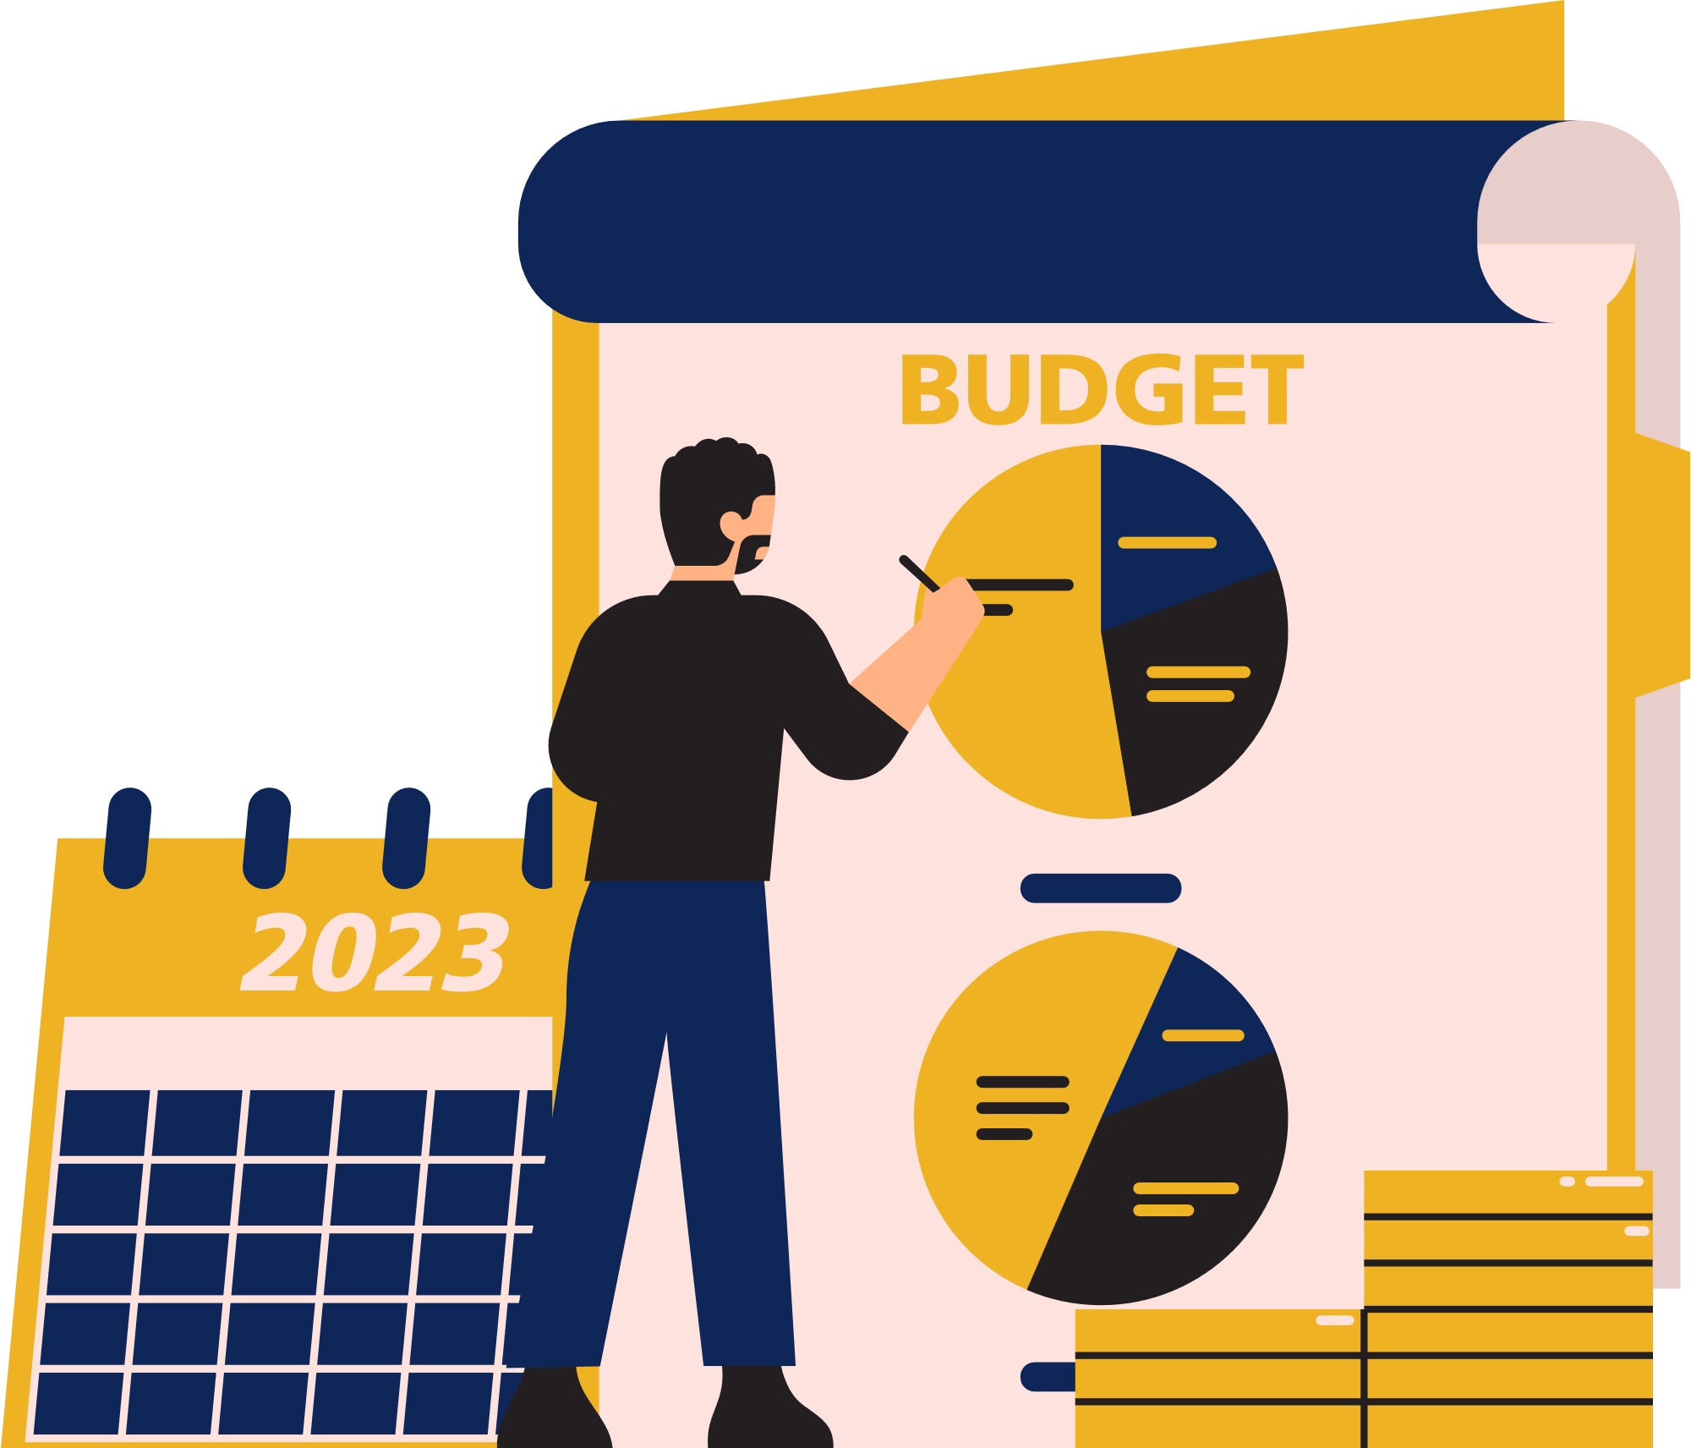

VOYAIGE
05/17
Goals
Enhance Personalization
Reduce Trip Planning Time
Optimize Budget Management for Travel
Deliver Reliable Recommendations for User

Slide 7



VOYAIGE
06/17
Existing
Systems
TripAdvisor
RoutePerfect
Expedia

Slide 8
VOYAIGE
07/17
Existing
Systems
Pros | Cons
Very easy to use | Doesn’t provide recommendations for specific areas.
Gives users multiple options | Website has no use of AI

Slide 9
VOYAIGE
08/17
Existing
Systems
Pros | Cons
Includes a chatbot that provides itineraries | Limited coverage - doesn’t plan trips in Pakistan
Gives users multiple options | When planning itineraries, interface becomes too cluttered

Slide 10
VOYAIGE
09/17
Existing
Systems
Pros | Cons
Easy to use | Chatbot provides links to user only
Seamless booking options | Doesn’t plan itineraries - only helps in booking

Slide 11








VOYAIGE
10/17
Scope and Modules
1. Chatbot
5. Panoramas
2. Form-based Recommendation
6. Booking Methods
3. User
Customization
7. Payment Options
4. Pre-Planned Trips
8. Challenges

Slide 12
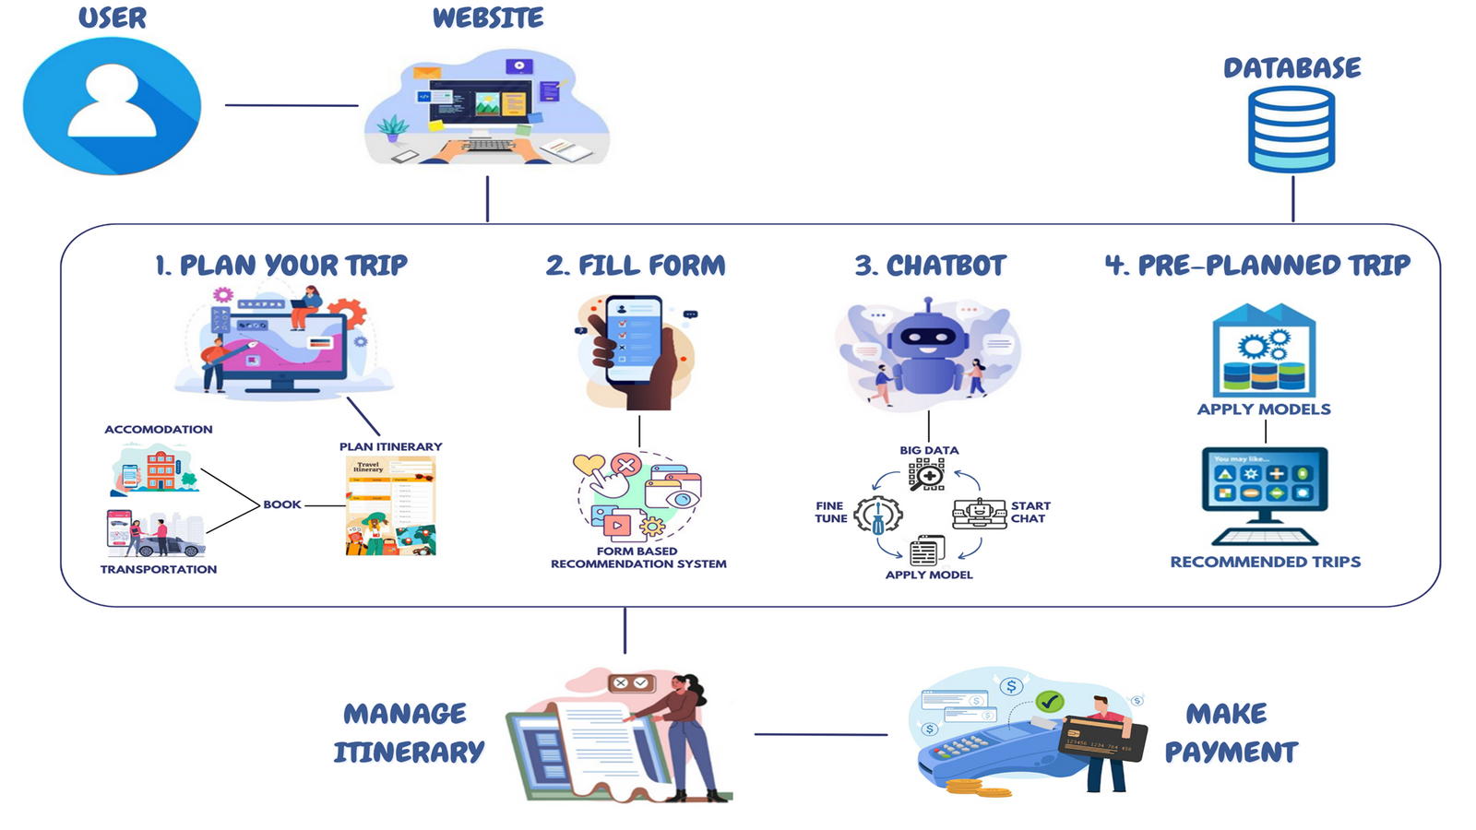
VOYAIGE
11/17
Process Flow

Slide 13







VOYAIGE
12/17
Tools
Figma
REACT
Express.js
Node.js
MongoDB
Jupyter Notebook
Python
VS Code

Slide 14
VOYAIGE
13/17
Technologies | Hamza Rauf | Shamail Aamir Khan | Eman Furrukh
Javascript | 7 | 6 | 6
React | 7 | 7 | 6
Express.js | 6 | 6 | 5
Node.js | 6 | 6 | 6
Python | 5 | 7 | 7
MongoDB | 5 | 7 | 7
Figma | 6 | 7 | 7
Github | 8 | 5 | 6
MS Word | 9 | 8 | 9
MS Powerpoint | 8 | 7 | 8
Skill
Assessment

Slide 15
VOYAIGE
14/17
TASKS
ITERATION 1
ITERATION 2
ITERATION 3
ITERATION 4
Aug
Sept
Oct
Nov
Dec
Jan
Feb
Mar
Apr
May
June
UI/UX
PROTOTYPING (FIGMA)
WEB SCRAPING
CHATBOT
Timeline
FORM-BASED RECOMMENDATION
CHALLENGES
PRE-PLANNED TRIP
(RECOMMENDED)
PANORAMAS
USER CUSTOMIZED TRIP
BOOKING SYSTEMS
PAYMENT METHODS
TESTING/DEBUGGING
DEPLOYMENT

Slide 16
VOYAIGE
15/17
Work Division
Shamail Aamir Khan
Hamza Rauf
Chatbot
User Customization
Form-Based Recommendation
Challenges
Eman Furrukh
Recommended Pre-Planned Trips
Panoramas

Slide 17
VOYAIGE
16/17
Conclusion

Slide 18
VOYAIGE
17/17
Thank You,
Any Questions?

Slide 19
VOYAIGE
17/17
References
TravelPerk (2024), “60+ online travel booking statistics & trends”, 2024 Article
Link: https://www.travelperk.com/blog/online-travel-booking-statistics/
1: “Travelers spent over 5 hours consuming online travel content to seek inspiration and plan their trip in the 45 days before finally booking their journey.”
2: “One of the biggest factors hampering travel bookings was the lack of transparency. Comparing too many options is challenging and becomes a roadblock.”
3: “60% of surveyed travelers believed travel options were filled with hidden costs and were not upfront enough.”

Slide 20
VOYAIGE
17/17
References
Research Paper Link:
https://d1wqtxts1xzle7.cloudfront.net/71287773/1002-libre.pdf?1633349130=&response-content-disposition=inline%3B+filename%3DA_Study_of_Factors_Affecting_Travel_Deci.pdf&Expires=1725080865&Signature=LRH1caabEfAYOR6guj56Y78VqwD5paeWuYVUi6SQiAHmiz6qBi473WEjz0m9H84Y7YPBjT7cqyOYlpcmM50TghoWiKvHr1hCLX1j7~b5k0hMt3RRvlq54uB6ygJLRKhJ-8hRYluzvaxIaW8x-FJHn2hkoO4t83GWDOybfA84ne~Stq8TYISinx34PH8VEY0gN9v0JWTa~Mg~v-ienTmNpnfpFg7A5csy7uYW-UbmTrjZQeLPIIl82i7h~44x2~9NQU3tHxYlaruUbHe9SzoqtCITnDph0WjzWMgfhMg97yZD-0cl4vBVgvetKe4NTD3KLhEH8ZHp4PV2AjRAE4n5bw__&Key-Pair-Id=APKAJLOHF5GGSLRBV4ZA

Slide 21
VOYAIGE
17/17
Appendix
Airbnb Data
Tourist Attractions Data

